Slide 1
Week 8 (3) – Warshall’s Algorithm
CST370 – Design & Analysis of Algorithms
Dr. Byun
Computer Science

Slide 2
Lecture Objectives
After completion of this lecture, you will be able to
  understand the meaning of the transitive closure in a directed graph and calculate it using the Warshall's algorithm.

Slide 3
Warshall’s Algorithm – Introduction
Warshall’s algorithm is to compute the transitive closure of a directed graph.
To learn the basic concept of transitive closure, watch this video from the beginning to 9:13.
  https://goo.gl/HW3QmF

Slide 4
Warshall’s Algorithm – Introduction
Read the Google document below to understand the basic operation of the Warshall algorithm.
  https://goo.gl/zthtJA

Slide 5
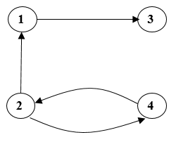
Exercise
Assume that we have the following directed graph.
  Present R⁽⁰⁾, R⁽¹⁾, R⁽²⁾, R⁽³⁾, and R⁽⁴⁾ as we discussed in the Google document.
Do not see the answer immediately.
  Try to solve it by yourself.

Slide 6
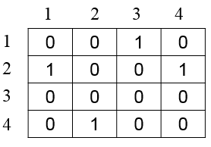
Solution – R⁽⁰⁾
R⁽⁰⁾ is the initial adjacency matrix.
  So, this is R⁽⁰⁾.

Slide 7
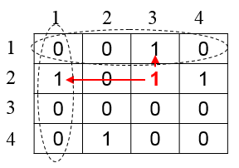
Solution – R⁽¹⁾
For R⁽¹⁾, we should consider the node 1 (= first row and first column).
  We can find a new path from 2 to 3 through the node 1.

Slide 8
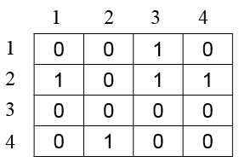
Solution – R⁽¹⁾
This is the updated adjacency matrix named R⁽¹⁾.
  Similarly, we can determine R⁽²⁾, R⁽³⁾, and R⁽⁴⁾ which are described in the next slides.

Slide 9
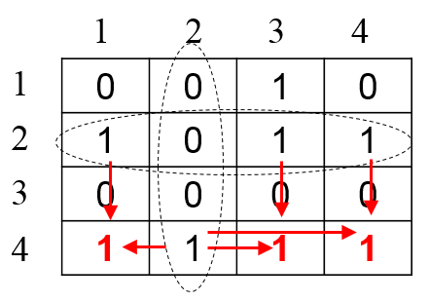
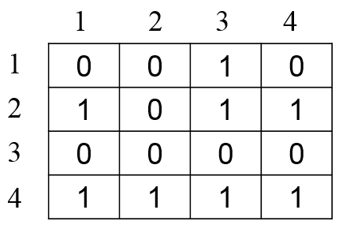
Solution – R⁽²⁾
➔

Slide 10
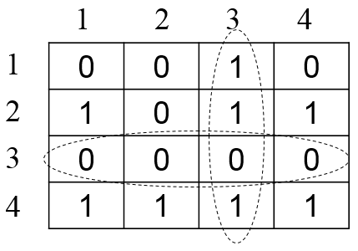
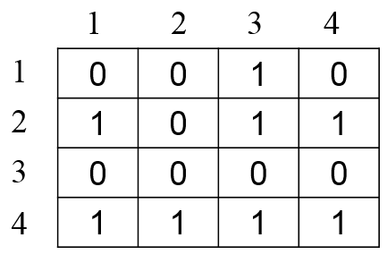
Solution – R⁽³⁾
➔

Slide 11
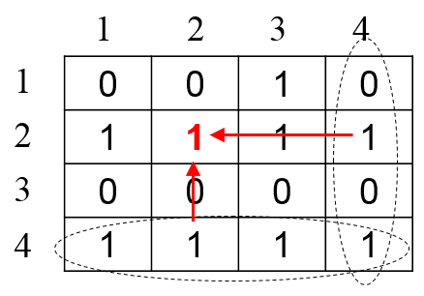
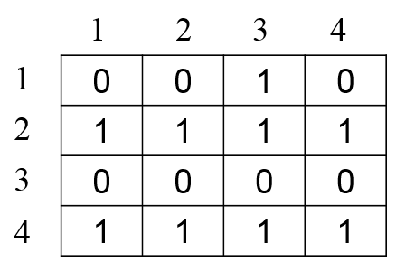
Solution – R⁽⁴⁾
➔

Slide 12
<<< Course Instruction >>>
Read pages 304-308 in the textbook and proceed to the next slide.
  If you can solve the exercise, you have a thorough understanding of the basics of the Warshall algorithm.
  By reading the textbook, you will be able to implement it in a programming language.

Slide 13
Puzzle: Missionaries and Cannibals
Three missionaries and three cannibals must cross a river.
  Their boat can only hold two people.
  Each missionary and each cannibal can row the boat.
  If present, missionaries cannot be outnumbered by cannibals.
  How can all six people get across the river with the fewest crossings?

Slide 14
Important Note
Do not immediately see the answer on the next page.
Hints
  The puzzle can be solved in 11 river crossings.
  Try to draw the crossings on paper.

Slide 15
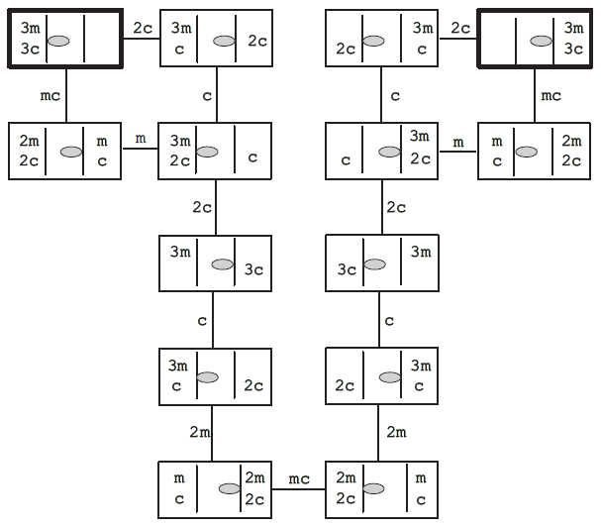
Solution
Two bars “| |” in the rectangle denote the river and the shaded oval shows the boat’s location.
The starting point is the rectangle at the top left.

Slide 16
<<< Course Instruction >>>
This lecture is over.
  When you are done, study the next lesson (week_8_4.ppt) on the iLearn.

